Slide 1
Research Project Proposal
Utilising and adapting IoT technology in secondary education in the United States (US)
Name: Bee Teck Ivan Chua
Notes:
Slide 1: Research Project Proposal
Hello everyone, my name is Ivan Chua,
This is my research proposal on Utilising and adapting IoT technology in secondary education in the United States (US)

Slide 2
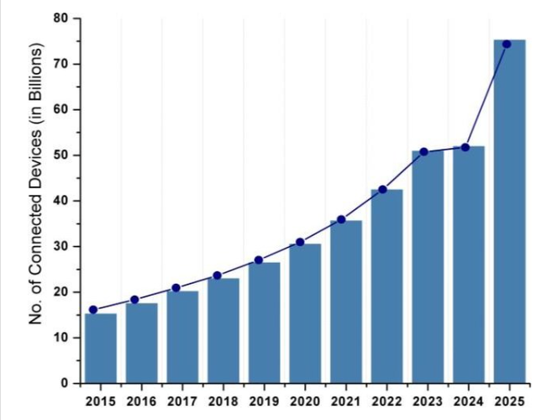
Introduction
Figure 1: IoT Connected devices installed worldwide (Ali et al,2020).
Notes:
Slide 2: Introduction
The internet of things (IoT) is a term for the ever-growing network of physical objects that are connected to the internet. While IoT technology refers to inclusion of hardware, software, tools, systems, sensors to support IoT device and application.
According to Ali et al (2020), as shown in Figure 1, currently, there are 40 billion IoT devices deployed worldwide and by 2025 the numbers are expected to reach 76 billion. Hearon et al (2021) also echoed the same findings IoT devices are making people’s lives easier and no wonder the number are increasing each year.
How about the use of IOT technology usage in the education sector the United States? Let’s look at the next slide.

Slide 3
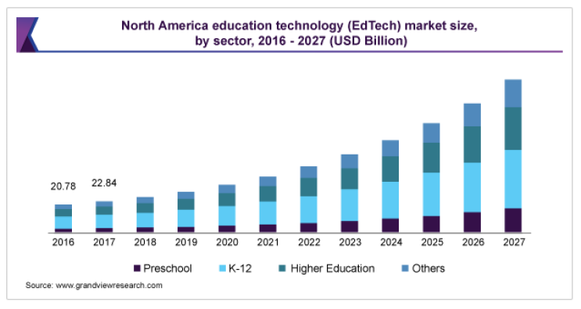
Introduction
Figure 2: Education Technology market size in North America (Grand View Research)
Notes:
Slide 3:
IoT technologies are being increasingly adopted in secondary education the US according to the search done by Grand View Research as shown in Figure 2.
These technologies can provide the students with new opportunities for learning, make learning more efficient and effective.
It’s therefore not surprise to see the utilisation and adoption continues to grow not only now but also in the future,
However, there are also a number of risks and challenges associated with using such technologies in education sector open bracket Hearon et al 2021 close bracket.
Let us look at an two examples

Slide 4
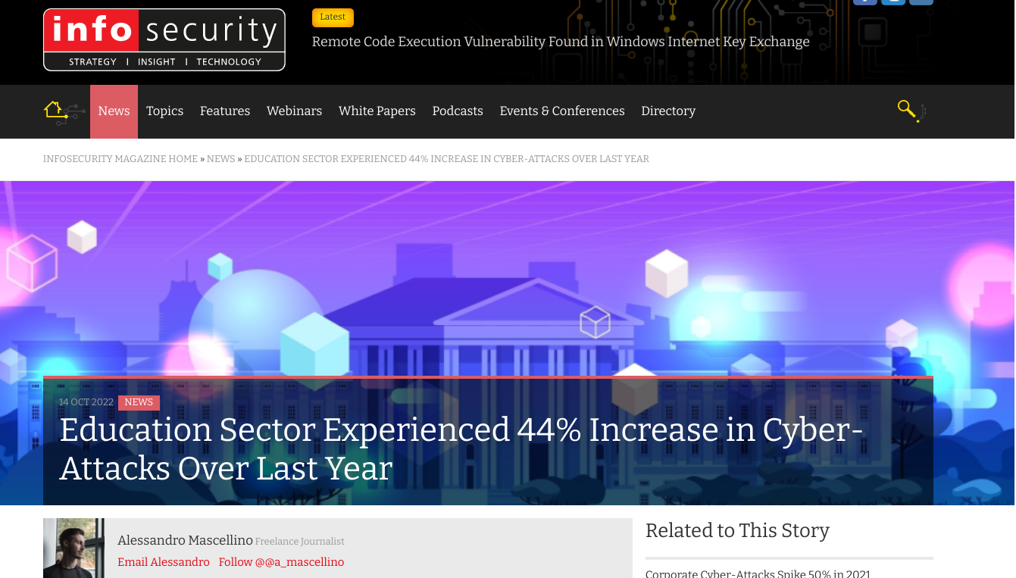
Introduction
Figure 3: Education sector experienced increasing cyber attack (InfoSecurity)
Notes:
Slide 4: first example.
According to InfoSecurity firm, the education sector in 2022 experienced a 44% increase in cyber-attacks when compared to 2021.
According to the report, they have found a major concern where the students connected to Free Wifi network without thinking about the security risks.
It is the ignorance and the lack of understanding about the security risks that gave the hackers the perfect opportunity to carry out the attack.

Slide 5
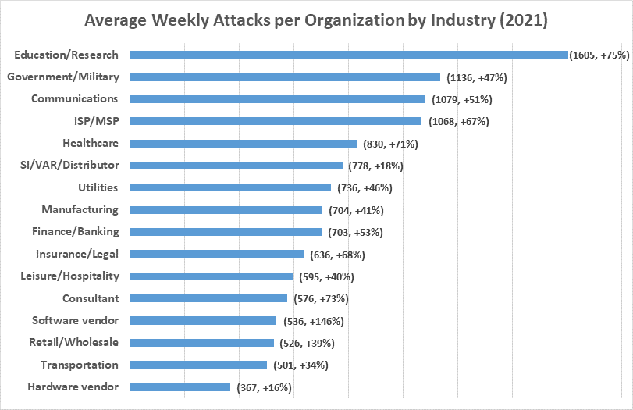
Introduction
Figure 4: Cyber-attacks per organization by Industry in 2021 (CHECK POINT SOFTWARE)
Notes:
Slide 5: second example
In another report published by CheckPoint (see Figure 4), there has been an increasing trend in the number of cyber-attacks.
In 2021 alone, the researchers have seen the highest volume of attacks in the education sector, with an average of 1,605 attacks per organisation every week.
According to Hess (2022), education and research has the highest attack because there is no standard practice or policy for cyber security.
It is up to the school to decide how to defend themselves, and not all schools take cyber security seriously.

Slide 6
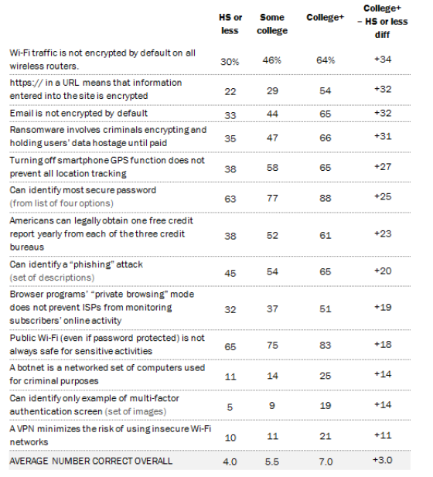
Significance of the research
There are many benefits of using IoT technologies in secondary school, but do the students know the risks associated with using such technology?
Figure 5: Cyber security knowledge by educational attainment (Pew Research Center)
Notes:
Slide 6: Significance of the research.
There are two of them.
First, while there are many benefits of using IoT technologies in secondary school, but do the students know the risks associated with using such technology?
Do the students have security awareness? Do they know how to identify a security threat?
The dangers of the IoTs, especially those students who are new to it, which means that the IoT devices are either unsecured or not secured properly. This could lead to a hacker hacking into them, taking control of the device or even using it to get access to school’s system to steal sensitive information. According to open bracket Hearon et al. 2021 close bracket there are many security challenges to overcome and one of them is student’s awareness of security risk.
In a survey conducted by Pew Research shown in Figure 5, high school students have lowest scores in cybersecurity knowledge compared to those in higher education and this is worrying.

Slide 7
Significance of the research
Lack of prior knowledge
Lack of basic electronics understanding
No coding experience
Evolving IoT devices
2. To deep dive into understanding the challenges faced by the students in learning IoT technologies.
Notes:
Slide 7:The second significance of this research is to deep dive into the challenges faced by the students in learning IoT technologies.
One of the biggest challenges that students face is lack of prior knowledge or have no previous exposure to the topic. In the research conducted by Schneider et at. (2020), it was noted that students without prior IoT knowledge have difficulty with the theoretical concept and more time have to be given to them to complete the assigned task.
Another group of students also reported having difficulty with handling of IoT technologies, primarily in relation to basic electronics as these were new concepts to them
According to Hearon et al (2021), the lack of knowledge in the students make them vulnerable to social engineering attacks.
Another challenge is the issue of coding. Many IoT applications require coding, and not all students are familiar with this language open bracket Schneider et at., 2020 close bracket.
It was however noted that there are many resources available to help students learn coding like the use of visual programming language rather than the traditional coding method.
Mechelen al et (2022) also highlighted that these emerging technologies were difficult for the secondary school students to comprehend due to complex and distributed nature.
Additionally, the vast majority of IoT devices are still new and constantly evolving, which makes it more challenging for students to keep up with the latest changes and updates open bracket Moskal, 2018 close bracket, leaving the students feeling bad and disengaged as if they were not making good progress.
Therefore, the teachers have an active role to play in guiding the student, ensuring IoT devices are used properly and securely as cited by Hearon et al (2021) and Mechelen al et (2022)

Slide 8
This is is left blank
Notes:
Slide 8: This page is left blank

Slide 9
Research project aims and objectives
Aims and objectives
Assess if the students are aware of the risks associated with using IoT Technologies in secondary education.
To raise security risk awareness among the students they play a part in the overall security wellness of the school.
Identify the challenges faced by the secondary students in learning IoT technologies
To raise student’s ability awareness to the school management so that additional can be given to the students
Notes:
Slide 9: The aim and objective of this research are:
Assess the level of security awareness of the student handling IoT in secondary education
In hope to raise security risk awareness among the students as they play a critical role in the overall security wellness of the school.
Identify the challenges faced by the secondary students in learning IoT technologies
In hope to raise student’s ability awareness to the school management so that help can be rendered to them

Slide 10
Research question(s)
Do the secondary students understand the risk associated with IoT technologies?
What are the challenges faced by secondary students in learning IoT technologies?
Notes:
Slide 10: The two research questions are:
Do the secondary students understand the risk associated with IoT technologies?
The students may be tech savvy but do they really have the risk knowledge and understanding? This is what the research question hopes to answer.
What are the challenges faced by secondary students in learning IoT technologies?
The students may have jumped into the IOT technology bandwagon due to its popular demand, but as secondary students, are they coping well?

Slide 11
Methodology/Development strategy/Research Design
The research methodology is based on the Emerging Synthesis (Schick-Makaroff et al., 2016) methodology as it includes quantitative, qualitative,and other types of data like policies, commentaries, etc.
In addition, online searches will be carried out using the Research Gate, ACM Digital Library, Google Scholar, the University of Essex Online Library platform and IEEE Xplore.
To stay current, 90% of articles published between 2015 and 2022 will be used and the remaining 10% should be within 15 years.
Notes:
Slide 11: Research Methodology
The research methodology is based on the Emerging Synthesis open bracket Makaroff et al, 2016 close bracket methodology as it includes quantitative, qualitative,and other types of data like policies, commentaries, etc.
In addition, online searches will be carried out using Research Gate, ACM Digital Library, Google Scholar, the University of Essex Online Library platform and IEEE Xplore.
Lastly, to stay current, articles published between 2015 and 2022 will be used in this research.

Slide 12
Ethical considerations and risk assessment
Keeping the participants informed the purpose of the survey, who and how the data will be used.
Obtain consent from the participants and they can withdraw anytime.
Maintaining integrity ensures accuracy and dissemination of research results and protects published evidence (Yip, 2016).
Ensure Test phishing email sent to the participant does not result in harm
Ensure PII not collected during the use of online survey platform and phishing test
Notes:
Slide 12: Ethical considerations
The participants will be given all the relevant information about the study.
This information should include the purpose of the study, the nature of the data that will be collected, how the data will be used, and who will have access to it.
The Participants’ consent will be required, and they should understand the risks in taking part in the study and that they are free to withdraw consent at any time.
Maintain integrity in ensuring the accuracy during publishing of the research result open bracket Yip 2016 close bracket.
During the survey, participants will be also consent if they would like to participate in a phishing test.
Should they agree, effort will be taken to sure no harm cause to the participants.
Lastly, to ensure Personal Identification Information or PII are not collected during the use of online survey platform and phishing test (e.g. IP addresses)

Slide 13
Risk assessment
Risk Item | Severity Level | Likelihood of Occurrence | Overall Risk | Action Taken
Accidentally collection of PII from participants | 3 | 1 | 3 | Ensure data anonymous and no IP addresses are collected by the survey platform and phishing test
Fail to obtain consent from participants | 3 | 1 | 3 | Survey testing prior to actual
Damage caused by the test phishing email | 2 | 1 | 2 | Conduct throughout test
Inaccurate presentation of information from primary and secondary research sources | 2 | 2 | 4 | Thorough checking of the research works
Legend:
Severity Level: 1 (Low), 2 (Medium), 3 (High)
Likelihood to happen: 1 (Low), 2 (Medium), 3 (High)
Overall Risk: A calculated value from multiplication of Severity Level and Likelihood
Any item which has a rating of greater than 3 requires attention and monitoring to ensure it is under control.
Table 1: Risk Management
Notes:
Slide 13: Risk Assessment
Based on the ethical consideration, a risk assessment was carried out.
For each risk item, a severity level rating and a likelihood of occurrence rating will be assigned.
An overall rating is computed by multiplying these two values and a value of greater than 3 requires attention, close monitoring and checking, to ensure it does not go out of control.
For Severity Level, there are 3 levels: 1 - Low, 2 - Medium , 3 - High. It is an indication how severe the risk should it happened.
For Likelihood of occurrence, there are also 3 levels similar to severity level. It is an indication of how likely the risk will occur.
From the risk assessment analysis as shown in Table 1.
Focus needs to be given to ensure accuracy in presentation of information from primary and secondary research sources, as it has a rating of 4.

Slide 14
Key literature related to the project.
Author(s) | Key themes / findings
Hearon et al (2022) | Discuss issues and challenges related IoT and security breaches caused by user and system vulnerability.
Makaroff et al (2016) | Provide guidance on the research methodology
Mechelen et al (2022) | Discuss challenges and impact of emerging technologies on student and the role of teachers
Schneider et al (2020) | Discuss the challenges faced by students in using IoT technologies
Table 2: Key literature related to the project.
Notes:
Slide 14: There were a number of literature material available related to this research. The key ones are shown in Table 2:
1. Hearon et al (2022)
It discusses the issues and challenges related IoT and security breaches caused by user and system vulnerability.
2. Moskal et al (2022)
It provides report on the opportunities and challenges of incorporating IoT in education
3. Schneider et al (2020)
It discusses the challenges faced by students in using IoT technologies
4. Makaroff et al (2016)
It provides guidance on the research methodology

Slide 15
Description of artefact(s) that will be created
Answers and responses from questionnaires.
Test phishing results from the participants
Findings and conclusions from the questionnaire analysis
Provide recommendations for research questions.
Notes:
Slide 15: Artefacts that will be created in this research project
1. Answers and responses from questionnaires.
This is done via online survey platform and in person interviews should there be a requirement.
2. Test phishing results from the participants
The is the data collected from those who have consented to participate in the phishing test.
3. Findings and conclusions from the questionnaire analysis, phishing test will be filed together with the raw data.
4 Provide recommendations for research questions.
As part of this project, observation and recommendations will be made available to the school management, it will be part of the artefacts

Slide 16
Timeline of the proposed activities
Task Description | Duration
Dissertation Preparation Research Proposal and feedback from tutor | 5 - 6 weeks
Literature Review | 4 - 5 weeks
Revise research question, design and methodology | 2 - 3 weeks
Obtain approval from the schools and the parent or guardian of the students from the targeted schools | 5 - 6 weeks
Questionnaire design and creation, including testing and correction | 2 - 3 weeks
Refine the questions in the questionnaire, if needed | 1 - 2 weeks
Conduct the online survey and respond to queries Carry out phishing test | 4 - 5 weeks
Data analysis and interpretation of the results | 3 - 4 weeks
Preparation and submission of the Research Report | 5 - 6 weeks
Total Duration | 31 to 36 weeks
Table 3: Timeline of the proposed activities
Notes:
Slide 16: Timeline for the proposed activities.
As shown in Table 3, the minimum duration 31 weeks and maximum is 36 weeks.
The buffer timeline is in anticipation of additional time required to obtain participant’s consent and carrying out the survey.
This is an estimated timeline of the proposed research activities. See Table 3.
1. Preparation Research Proposal, Feedback from tutor: 5 - 6 weeks
2. Literature Review: 4 - 5 weeks
3. Revise research question, design and methodology, if any: 2 - 3 weeks
4. Obtain approval from the schools and the parent or guardian of the students from the targeted schools: 5 - 6 weeks
5. Questionnaire design and creation, including testing and correction: 2 - 3 weeks
6. Refine the questions in the questionnaire, if needed: 1 - 2 weeks
7. Conduct the online survey and respond to queries: 4 - 5 weeks
At the same time, phishing test will be conducted
8. Data analysis and interpretation of the results: 3 - 4 weeks
9. Preparation and submission of the Research Report: 5 - 6 weeks

Slide 17
References
Alessandro Mascellino (2022), Education Sector Experienced 44% Increase in Cyber-Attacks Over Last Year.
https://www.infosecurity-magazine.com/news/education-experienced-44-increase [Accessed: 22-Nov-2022]
Ali, Omer & Ishak, Mohamad Khairi. (2020) Bringing intelligence to IoT Edge: Machine Learning based Smart City Image Classification using Microsoft Azure IoT and Custom Vision. Journal of Physics: Conference Series. 1529. 042076. DOI:10.1088/1742-6596/1529/4/042076
Check Point Research: Cyber Attacks Increased 50% Year over Year (2021),
https://blog.checkpoint.com/2022/01/10/check-point-research-cyber-attacks-increased-50-year-over-year/ [Accessed: 24-Nov-2022]
G. Schneider, F. Bernardini and C. Boscarioli, "Teaching CT through Internet of Things in High School: Possibilities and Reflections," 2020 IEEE Frontiers in Education Conference (FIE), 2020, pp. 1-8, doi: 10.1109/FIE44824.2020.9274184
Rick Hess (2022), Why Are Schools a Target for Cyberattacks? https://www.edweek.org/technology/opinion-why-are-schools-a-target-for-cyberattacks/2022/10 [Accessed: 22-Nov-2022]
Notes:
Slides 17 to 19 are the references used in this research proposal.
Thank you and this is the end of the research proposal.

Slide 18
References
KENNETH OLMSTEAD AND AARON SMITH (2017), What the Public Knows About Cybersecurity https://www.pewresearch.org/internet/2017/03/22/what-the-public-knows-about-cybersecurity/ [Accessed: 23-Nov-2022]
Mary Elliot (2022) Top Cybersecurity Statistics for 2022
https://www.cobalt.io/blog/top-cybersecurity-statistics-for-2022 [Accessed: 21-Nov-2022]
Maarten Van Mechelen, Rachel Charlotte Smith, Marie-Monique Schaper, Mariana Aki Tamashiro, Karl-Emil Kjær Bilstrup, Mille Skovhus Lunding, Marianne Graves Petersen, Ole Sejer Iversen (2022) Emerging Technologies in K–12 Education: A Future HCI Research Agenda. https://doi.org/10.1145/3569897
Moskal, M., Christian, A., Laurenson, T. and Rountree, N., (2018) Internet of Things” as a capstone project: reflections on an educational initiative. Retrieved from Cintrenz: https://www.citrenz.ac.nz/conferences/2018/pdf/2018CITRENZ_1_Moskal_IoT.pdf
O'hearon, Keejoh & Mckee, Michael & Hossain, Nour & Canbaz, M Abdullah. (2021). IoT Privacy and Security in Teaching Institutions: Inside The Classroom and Beyond.
https://peer.asee.org/iot-privacy-and-security-in-teaching-institutions-inside-the-classroom-and-beyond.pdf [Accessed: 22-Nov-2022]

Slide 19
References
Schick-Makaroff, Kara & MacDonald, Marjorie & Plummer, Marilyn & Burgess, Judy & Neander, Wendy. (2016) What Synthesis Methodology Should I Use? A Review and Analysis of Approaches to Research Synthesis. AIMS Public Health. 3. 172-215. 10.3934/publichealth.2016.1.172.
http://dx.doi.org/10.3934/publichealth.2016.1.172
Susan Morrow (2020), Critical security concerns for the education industry
https://resources.infosecinstitute.com/topic/critical-security-concerns-for-the-education-industry/ [Accessed: 22-Nov-2022]
Yip C, Han NR, Sng BL (2016) Legal and ethical issues in research. Indian J Anaesth Sep;60(9):684-688. DOI: 10.4103/0019-5049.190627. PMID: 27729698; PMCID: PMC5037952.
Victor Rivero (2020), EdTech Market Size 2016-2027
https://www.edtechdigest.com/2020/11/19/edtech-market-size-2016-2027/
[Accessed: 22-Nov-2022]

